Slide 1
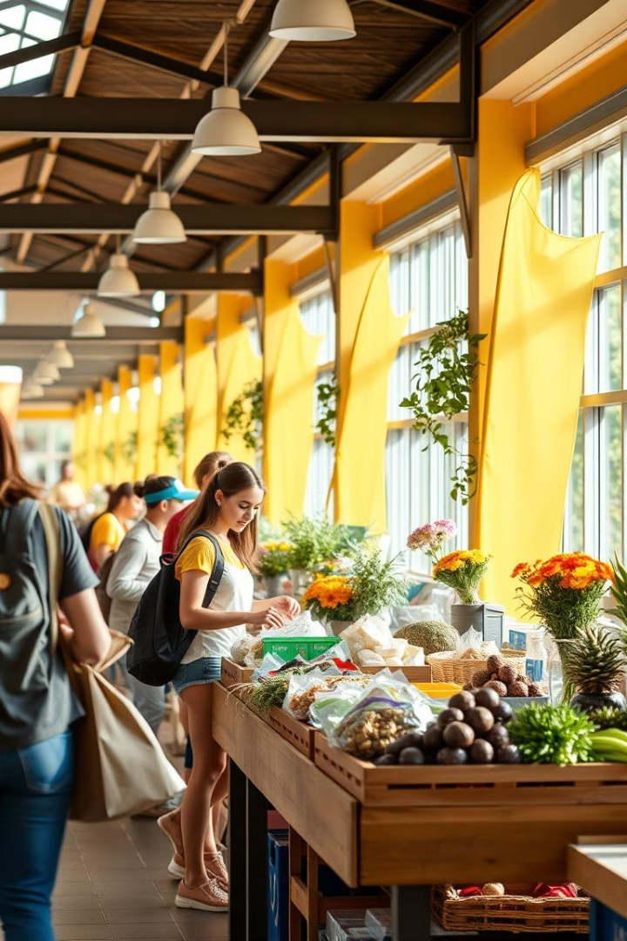
Kuza Market
Buy, Sell, Save – Sustainably.
ThinkGrind Group
BCS Group 6
Made by Kuza Market Team

Slide 2




The Problem: Affordability & Waste
Unaffordable essentials
Usable items trashed
Many usable items end up in the trash at semester's end.
Students struggle to afford books, electronics, and furniture.
Broad platforms
Existing platforms are too broad or unsafe for campus trades.

Slide 3

Our Solution: Kuza Market
Campus Marketplace
A trusted marketplace for students.
Buy & Sell
Easily buy and sell secondhand items.
Campus Community
Trade within your campus community.
Sustainable Living
Promote sustainable and affordable living.

Slide 4
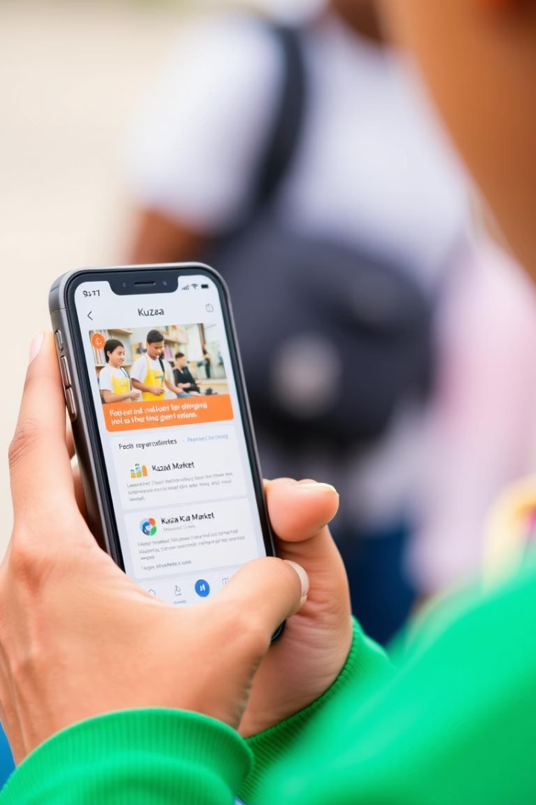







Key Features: Built for Students
Secure Messaging
Verified Profiles
Campus Listings
Secure in-app messaging.
Verified student profiles.
Campus-specific product listings.
Easy Search
GPRS
Safe pickup points
Easy search and filtering.
integration of maps for easy meetups
Safe meet ups
Smart AI Recommendation
based on previous searches

Slide 5
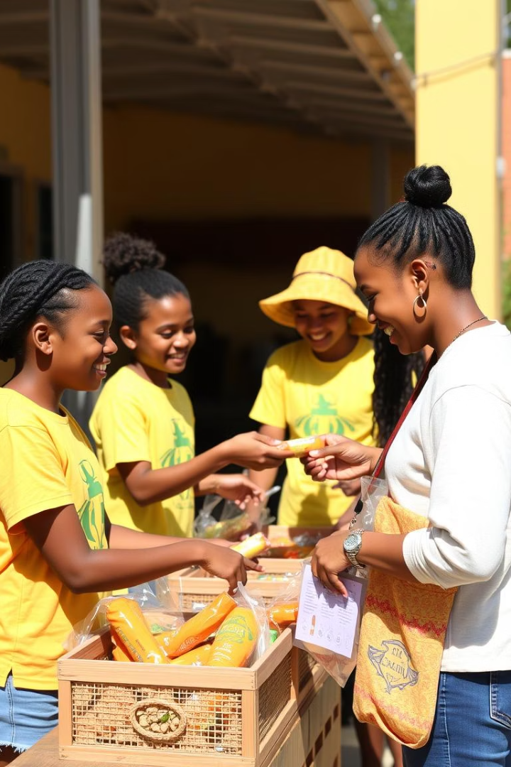




Benefits: Savings, Sustainability, Community
Save Money
Save on essential items.
Sustainability
Reduce waste and promote sustainability.
Campus Community
Build community through trade.
Safe Transactions
Convenient and safe transactions.

Slide 6



How it Works: Simple & Intuitive
Visit the Website
Visit the Kuza Market website app.
Create Profile
Create your student profile.
Browse/List Items
Browse or list items.
List items for sale or trade. Connect with other students securely.

Slide 7

Project Overview
This project was built using a modern tech stack including React, Supabase, shadcn, Vite, TypeScript and Git for Collaboration
Notes:
• This project was built using a modern tech stack including React, Supabase, shadcn, Vite, and TypeScript. • It's a class project that my group and I worked on together. • In the next slide, I'll provide more details about the specific features and functionality we implemented. • For now, I want to set the stage and give the audience a sense of the tools and technologies we leveraged to bring this project to life.

Slide 8
Features & Functionality Implemented
We built secure, verified profiles to connect students safely. Our campus-specific listings make finding local items easy and relevant.
Smart AI-tailored recommendations surface items based on user preferences and search history. We integrated GPRS maps to enhance meetup safety.
Search and filtering tools improve usability, helping students quickly find what they need, fostering sustainable trading across campus.
Secure Messaging
Verified Profiles
Encrypted chats to protect user communication and privacy.
Ensures authentic users to build a trustworthy community.
AI Recommendations
GPRS Map Integration
Personalized suggestions based on past searches and preferences.
Easy location tracking for safe and convenient meetups.

Slide 9
Admin Functionality
User Management: Admins can verify profiles and manage community safety.
Content Moderation: Monitoring listings to maintain a trustworthy marketplace.
Data Analytics: Insights on user activity help improve platform features.
Security Controls: Ensure secure transactions and protect user data.

Slide 10





Join the Kuza Market Movement!
Download the App
Buy/Sell/Save
Download the app today.
Start buying, selling, and saving.
Social Media
Campus Partnerships
Follow us on social media: @KuzaMarket
Contact us for partnerships!

